Slide 1
React Bootcamp
Alexander Kucksdorf, Michel Frenken & Christian Noll

Slide 2
React Bootcamp
Vladimir Daskalov & Alexander Kucksdorf

Slide 3

Timetable
Start: 09:00
15 min coffee break @ ~11:00
Lunch: 12:15-13:15
15 min coffee break @ ~15:30
End: 17:00
Notes:
https://pixabay.com/images/id-4241785/

Slide 4
React Bootcamp Overview
Day 1
Introduction Round
Setup Environment
Typescript Refresher
Ecosystem
Introduction to React
First look at *.jsx & *.tsx
Set up a Typescript React App
React Component Types
State-Driven UI
Component Lyfecycle
Theme & Styling
Material-UI
Day 2
Data-Modeling
Lists
Hooks
Refs
Subscribing to Events
Context
Routing
Testing
Redux
MUI DataGrid
IssueTracker
Day 3
Internationalization
Notes App
React-Query

Slide 5

Say Hi
What is your background
Expectations for the training

Slide 6





Setup Environment
SETUP
> node –v
v22.X.X
https://nodejs.org/en/download/
https://code.visualstudio.com/download
https://marketplace.visualstudio.com/items?itemName=nrwl.angular-console
https://marketplace.visualstudio.com/items?itemName=usernamehw.errorlens
https://marketplace.visualstudio.com/items?itemName=esbenp.prettier-vscode

Slide 7

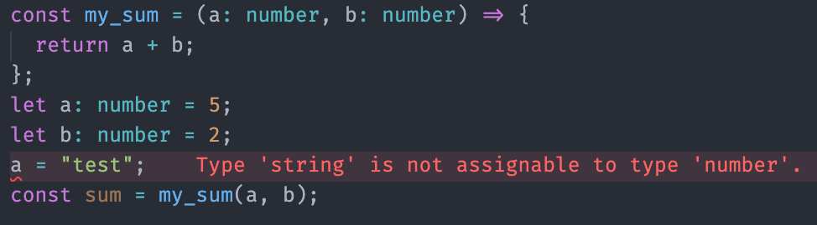
Typescript Refresher
Superset of JavaScript
Compiles to JavaScript (cannot be directly executed in Browser or NodeJS; runs in Deno)
Static typing (on demand e.g. boolean, number, string, any, interfaces)
Compile time type safety e.g. avoid the classic 'undefined' is not a function.
.ts file extension instead of .js
Created and maintained by Microsoft
“Safety at Scale”
https://www.typescriptlang.org
Notes:
Accessing non existing properties or functions

Slide 8

Install React
JS library for building UIs
Not a Framework!
Component Based Development
Declarative (we describe our UI)
State-Driven UI (UI is a function of the data)
Virtual DOM
https://react.dev/learn/installation

Slide 9
Not a Framework
React doesn‘t provide guidelines for:
Routing
Styling
Network communication
Async tasks handling
Internationalisation
etc.

Slide 10
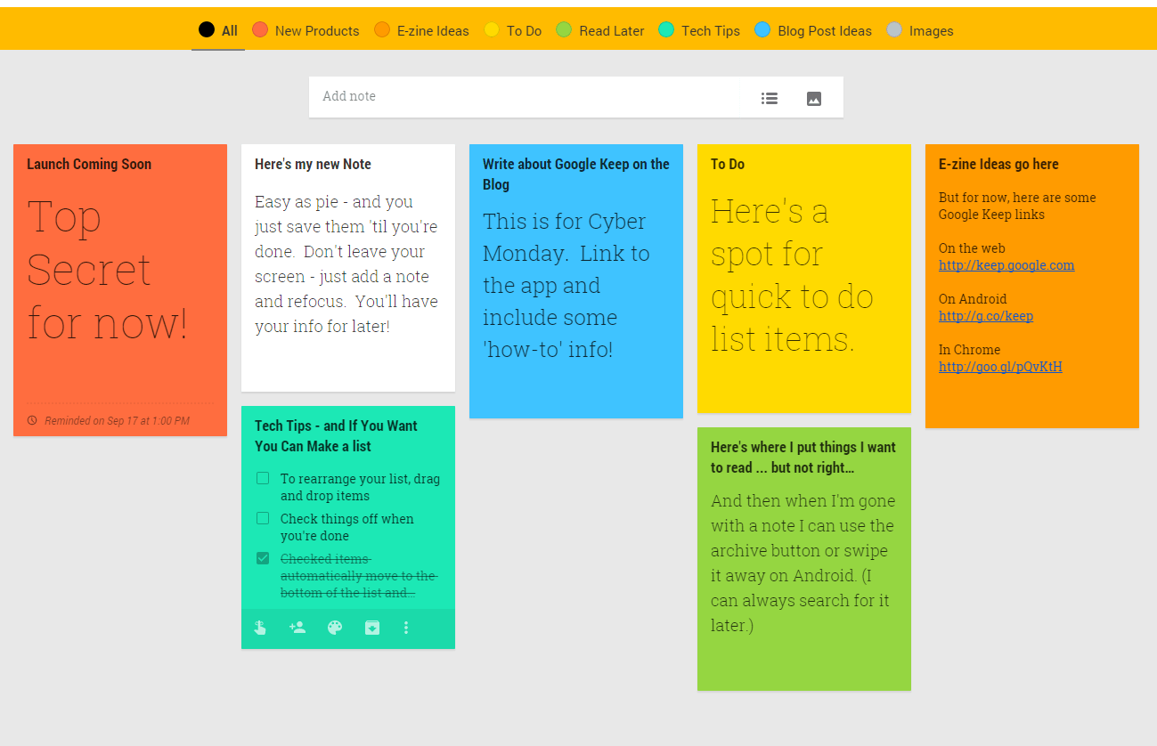
Everywhere Components

Slide 11

Let’s jump right in
Notes:
https://pixabay.com/images/id-3410807/

Slide 12
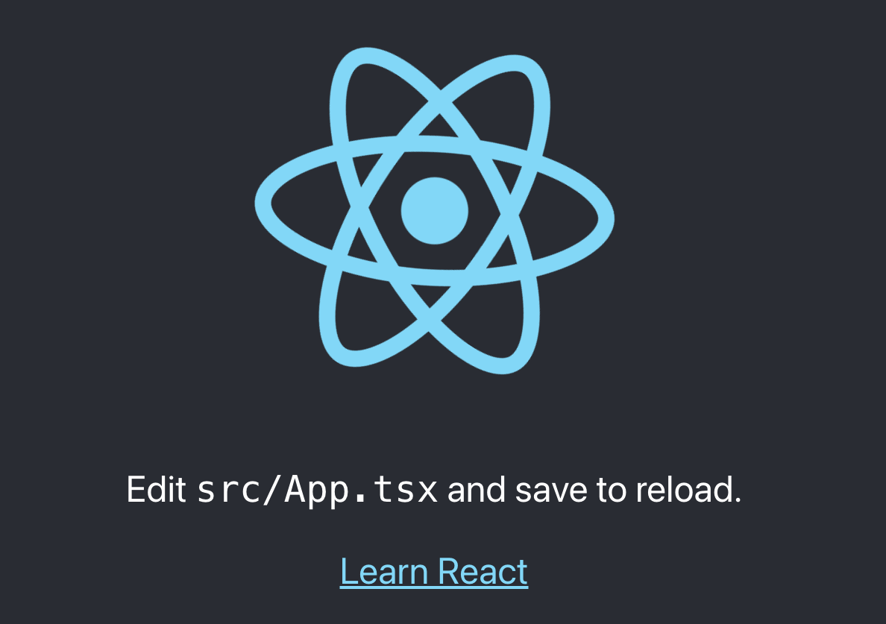
Create React App
> npx create-react-app react-training-app --template typescript
> cd react-training-app
> npm i
> npm start

Slide 13
Folder Structure
react-training-app/
node_modules/
package.json
tsconfig.json
public/
index.html
favicon.ico
src/
App.css
App.tsx
App.test.tsx
index.css
index.tsx
logo.svg
components/
models/
node_modules/ | All dependencies
package.json | Project information and dependencies
tsconfig.json | Typescript compiler configuration
index.html | Entry point for the browser
App.tsx | Root Component
index.css | Global styling
index.tsx | Bootstraps the application (render root component)
components/ | Directory for components
models/ | Directory for data models (interfaces only)

Slide 14
Scripts
"scripts": {
"start": "react-scripts start",
"build": "react-scripts build",
"test": "react-scripts test",
"eject": "react-scripts eject"
},
Override webpack configuration
https://www.npmjs.com/package/react-app-rewired

Slide 15
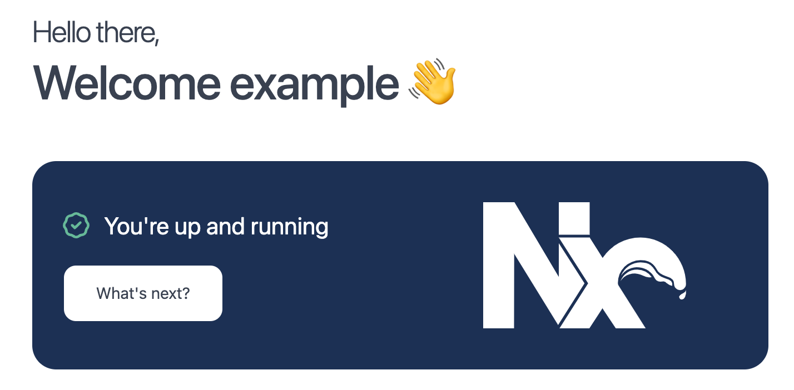
NX
> npx create-nx-workspace@latest
✔ Where would you like to create your workspace? · react-training-app
✔ Which stack do you want to use? · react
✔ What framework would you like to use? · none
✔ Application name · react-training-app
✔ Would you like to use React Router for server-side rendering
[https://reactrouter.com/]? · No
✔ Which unit test runner would you like to use? · vitest
✔ Test runner to use for end to end (E2E) tests · cypress
✔ Default stylesheet format · css
✔ Would you like to use ESLint? · Yes
✔ Would you like to use Prettier for code formatting? · Yes
✔ Which CI provider would you like to use? · github
> cd react-training-app
> npm start

Slide 16
Folder Structure
react-training-app/
node_modules/
package.json
tsconfig.json
src/
index.html
main.tsx
favicon.ico
app/
app.tsx
assets/
environments/
nx.json
project.json
webpack.config.js
node_modules/ | All dependencies
package.json | Project information and dependencies
tsconfig.json | Typescript compiler configuration
index.html | Entry point for the browser
app.tsx | Root Component
styles.css | Global styling
main.tsx | Bootstraps the application (render root component)
nx.json | Workspace configuration
project.json | Project configuration
webpack.config.js | Webpack configuration

Slide 17
Scripts
"scripts": {
"start": "nx serve",
"build": "nx build",
"test": "nx test"
},
> npx nx generate @nx/react:component --name=an-example --directory=app/components --export=false
In VS Code
Cmd/Ctrl + Shift + P
NX: generate
component

Slide 18
First look at JSX (JavaScript eXtension)
render() {
return (
<div>
Hello {this.name}!
</div>
);
}
JavaScript inside HTML inside JavaScript inside HTML inside …

Slide 19
JSX & JS Component
class HelloMessage extends React.Component {
render() {
return (
<div>
Hello {this.props.name}!
</div>
);
}
}
class HelloMessage extends React.Component {
render() {
return React.createElement(
"div",
null,
"Hello ",
this.props.name,
"!"
);
}
}
JSX
JS

Slide 20
Render a Component (ReactDOM)
<!DOCTYPE html>
<html lang="en">
<head>
<meta charset="utf-8" />
<title>React App</title>
</head>
<body><div id="root"></div></body>
</html>
index.html
ReactDOM.render(
<HelloMessage name="Taylor" />,
document.getElementById('root')
);
ReactDOM.render(
React.createElement(
HelloMessage,
{ name: "Taylor" }
),
document.getElementById('root')
);
JSX
JS

Slide 21
JSX & TSX Components
Component naming convention: Pascal case
class HelloMessage extends React.Component {
render() {
return (
<div>
Hello {this.props.name}
</div>
);
}
}
ReactDOM.render(
<HelloMessage name="Taylor" />,
document.getElementById('root')
);
HelloMessage.propTypes = {
name: PropTypes.string.isRequired
};
interface Props {
name: string;
}
class HelloMessage extends Component<Props> {
public render() {
return (
<div>
Hello {this.props.name}
</div>
);
}
}
ReactDOM.render(
<HelloMessage name="Taylor" />,
document.getElementById('root')
);
JSX
TSX

Slide 22
State Management
interface IState {
counter: number;
}
class HelloMessage extends Component<any, IState> {
constructor(props: any) {
super(props);
this.state = { counter: 0 };
// don't use this.setState(...) in the constructor
}
public render() {
return (
<div>
{this.state.counter}
<button
onClick={() => {
this.setState({ counter: this.state.counter + 1 });
}}
> click </button>
</div>
);
}
}

Slide 23
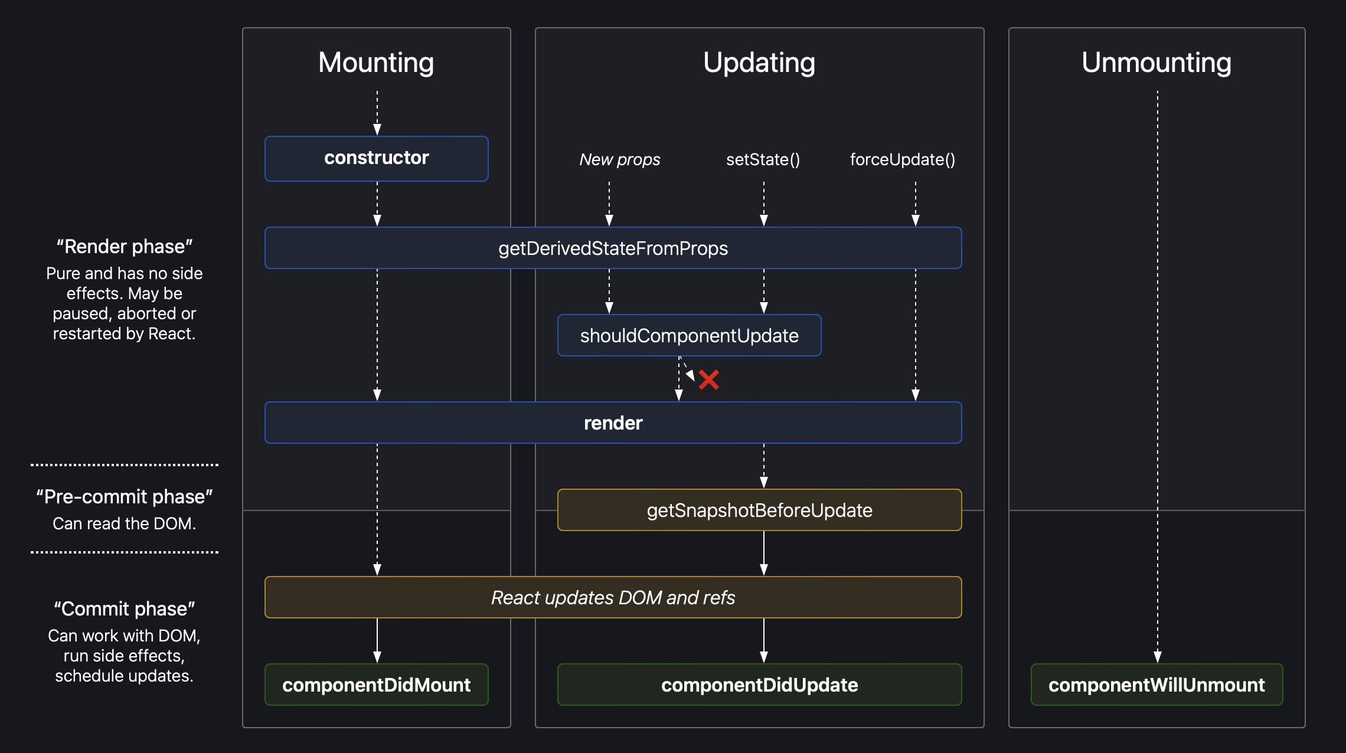
React Class-Component Lifecycle-Methods
https://projects.wojtekmaj.pl/react-lifecycle-methods-diagram/

Slide 24
Subscribing to Events
class HelloMessage extends React.Component<IProps, IState> {
private _myRef: React.RefObject<HTMLDivElement>;
constructor(props: IProps) {
this._myRef = React.createRef();
}
componentDidMount() {
if(null !== this._myRef.current) {
this._myRef.current.addEventListener('dragenter', this.onDragEnter);
}
}
componentWillUnmount() {
if(null !== this._myRef.current) {
this._myRef.current.removeEventListener('dragenter', this.onDragEnter);
}
}
onDragEnter() {
...
}
render() {
...
}
}

Slide 25
Functional Component
interface IProps {
name?: string;
}
const HelloMessage: React.FC<IProps> = ({name = 'Guest user'}) => {
return (
<div>
Hello {name}!
</div>
);
}

Slide 26
Functional Component State (useState hook)
const Counter: React.FC = (props) => {
const [counter, setCounter] = React.useState(0);
return (
<div>
Counter: {counter}!
<button onClick={()=> {
setCounter(counter + 1);
}}>increaase</button>
</div>
);
}

Slide 27
Functional Component Lifecycle (useEffect hook)
const Subscription: React.FC = (props) => {
React.useEffect(
() => {
const subscription = props.source.subscribe();
return () => {
subscription.unsubscribe();
};
},
[] // list of dependencies
// if not present - runs at every render
// if present but empty - run only once at the first render
// if present and dependencies listed - executes when any dependency changes
);
return (
<div>
Hi!
</div>
);
}

Slide 28
Hooks
useState | Allows you to store state in function components
useEffect | Allows you to perform side effects in function components
useMemo | Memorizes some expensive to recompute values and recomputes when any dependency changes
useRef | Returns a mutable ref object to access the DOM
use(Context) | Returns the current context value for that context
… | and more
Custom hook | Write your own hook
https://react.dev/reference/react

Slide 29
Refs
class HelloMessage extends React.Component {
private _myRef: React.RefObject<HTMLDivElement>;
constructor(props: IProps) {
this._myRef = React.createRef();
}
componentDidMount() {
if(null !== this._myRef.current) {
// Do something with the native node
}
}
render() {
return (
<div ref={this._myRef}>
Hello {this.props.name} !
</div>
);
}
}
const HelloMessage: React.FC = (props: any) => {
const ref = React.useRef<HTMLDivElement>(null);
React.useEffect(() => {
if (ref.current) {
// Do something with the native node
}
});
return (
<div ref={ref}>
Hello {props.name}!
</div>
);
};

Slide 30
React.Fragment
Component must return a single element
const List: React.FC = (props: any) => {
return (
<React.Fragment>
<div>one</div>
<div>two</div>
</React.Fragment>
);
};
const List: React.FC = (props: any) => {
return (
<>
<div>one</div>
<div>two</div>
</>
);
};

Slide 31
props.children
const Picture = (props) => {
return (
<div>
<img src={props.src}/>
{props.children}
</div>
)
}
…
render() {
return (
<Picture src={...}>
<Label>
Some Text
</Label>
</Picture>
);
}

Slide 32
Conditional Rendering
const HelloMessage: React.FC = (props: any) => {
return (
<>
{!!props.name &&
<div>Hello {props.name}!</div>
}
</>
);
};

Slide 33
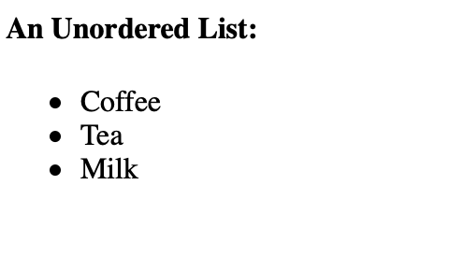
Show a list of items (Loops inside tsx)
const items = ['Coffee', 'Tea', 'Milk'];
…
<ul>
{
props.items.map((item) => {
return (
<li key={item}>
{item}
</li>
);
})
}
</ul>
key prop – needed for reconciliation (VirtualDOM - DOM)
Beware using idx as a key – might lead to problems if order changes

Slide 34
Composition over Inheritance
function Dialog(props) {
return (
<FancyBorder color="blue">
<h1 className=”dialog-title">
{props.title}
</h1>
<p className=“dialog-message">
{props.message}
</p>
</FancyBorder>
);
}
function WelcomeDialog() {
return (
<Dialog
title="Welcome"
message="Thank you for visiting!" />
);
}
Simpler to argue about
Care only about props and state
State driven

Slide 35
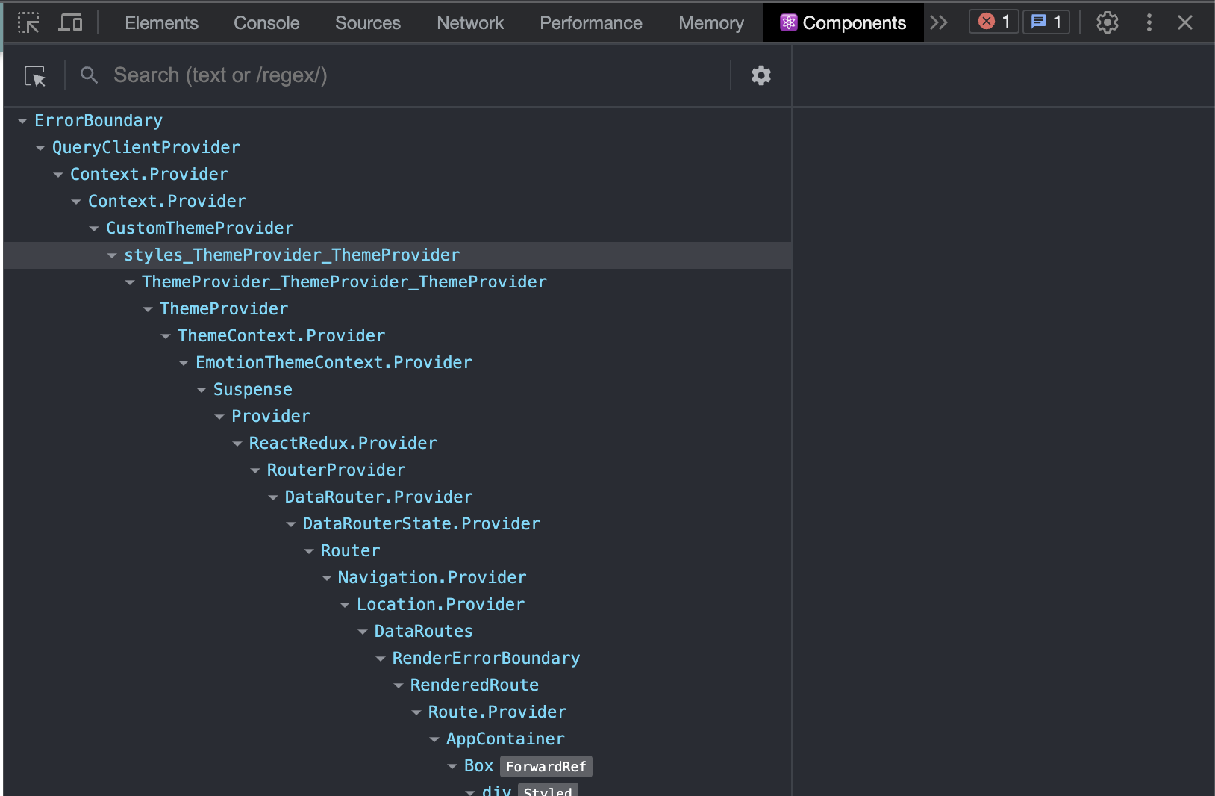
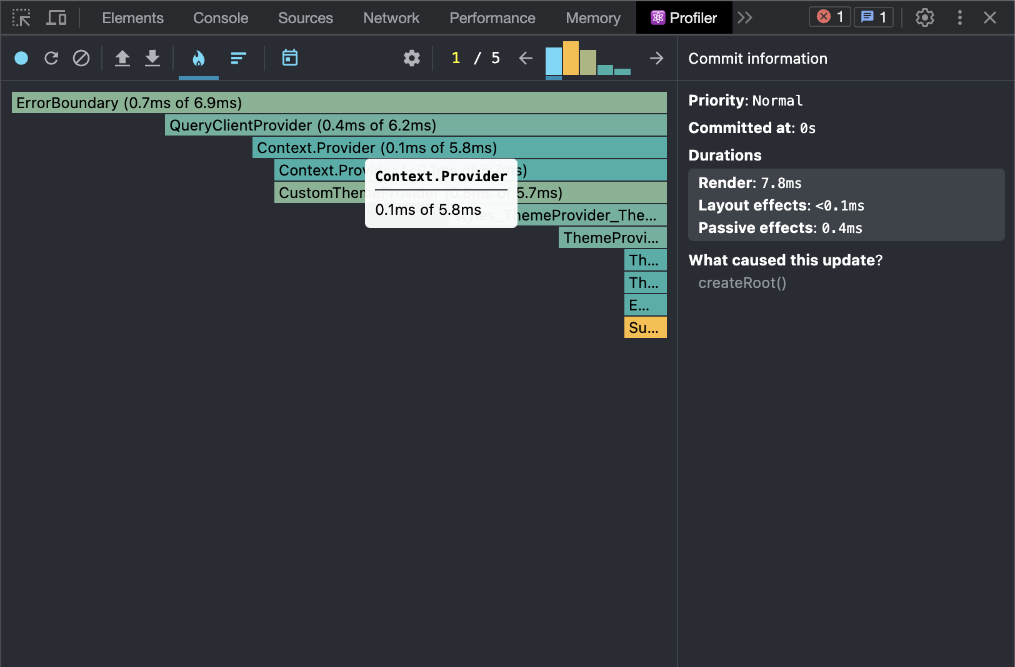
React Dev Tools
https://chrome.google.com/webstore/detail/react-developer-tools/fmkadmapgofadopljbjfkapdkoienihi?hl=en

Slide 36
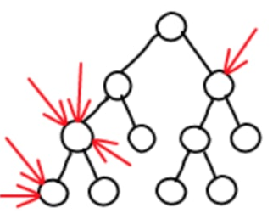
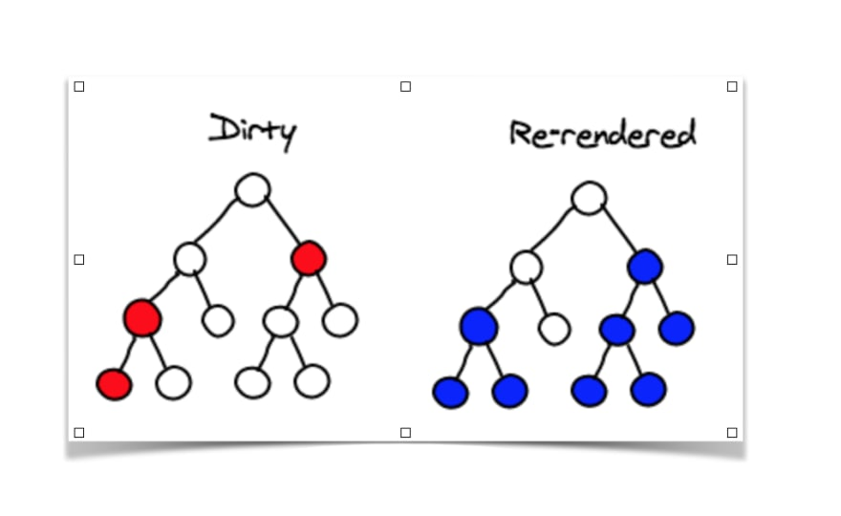
Virtual DOM
In-memory representation of the DOM
setState
dirty
re-rendered

Slide 37
Virtual DOM
setState
dirty
re-rendered
DOM
reconcile

Slide 38

Data Flow

Slide 39
Data Flow
Owned by the parent component
this.props
Owned by the component
HelloMessage.defaultProps = {
name: 'John'
};
this.state
this.setState({ counter: 1 });
const [counter, setCounter] = React.useState(0);

Slide 40
Data Flow
State can be passed to child components as props
class ParentComponent extends React.Component {
...
public render() {
<div>
<ChildComponent name={this.state.name} />
</div>
}
}
class ChildComponent extends React.Component {
...
public render() {
<div>
{this.props.name}
</div> }
}

Slide 41

Data Flow
this.props.name = 'ERROR';
// -----------------------

Slide 42
Data Flow
Update state in parent (with callbacks)
class ParentComponent extends React.Component {
constructor(props: IProps) {
super(props);
this.state = { name: "Default” };
}
…
<ChildComponent
name={this.state.name}
updateName={(name: string) => { this.setState({ name }); }}
/>
…
}
class ChildComponent extends React.Component {
…
public render() {
<div>
{this.props.name}
<button onClick={() => { this.props.updateName(""); }}>
clear name
</button>
</div>;
}
}

Slide 43

Flux (pattern)
Action
Dispatcher
Store
View
Action | Action is an object containing type property and an optional payload
Dispatcher | Takes a single action at a time and delivers it to the stores
Store | Stores the state and modifies the state based on actions from the dispatcher
View | React components listening to changes in stores (over props)
https://github.com/facebook/flux

Slide 44
Context
<Page user={user} avatarSize={avatarSize} />
// ... which renders ...
<PageLayout user={user} avatarSize={avatarSize} />
// ... which renders ...
<NavigationBar user={user} avatarSize={avatarSize} />
// ... which renders ...
<Link href={user.permalink}>
<Avatar user={user} size={avatarSize} />
</Link>
// ...

Slide 45
Context
const AvatarSizeContext = React.createContext('100px');
// ...
render() {
return (
<AvatarSizeContext.Provider value={'200px'}>
<Page user={user} />
</AvatarSizeContext.Provider>
);
}
// ... which renders ...
<Page user={user} />
// ... which renders ...
<PageLayout user={user} />
// ... which renders ...
<NavigationBar user={user} />
// ... which renders ...
<Link href={user.link}>
<Avatar user={user} />
</Link>
// ...
class Avatar extends React.Component {
static contextType = AvatarSizeContext;
render() {
return <img style={{width: this.context}} src="..."/>
}
}

Slide 46
Styling
Separate file
Inline
import styles from ‘./example.module.css';
...
public render() {
return (
<div className={styles.example}>
Hello {this.props.name}
</div>
);
}
const divStyle = {
height: '100%',
width: '100%',
padding: 0,
textAlign: 'center',
'&:hover': {
cursor: 'pointer'
}
};
const Box = () => (
<div style={divStyle}>
...
</div>
);

Slide 47
Controlled Components
class NameForm extends React.Component {
constructor(props) {
super(props);
this.state = {value: ''};
this.handleChange = this.handleChange.bind(this);
this.handleSubmit = this.handleSubmit.bind(this);
}
handleChange(event) {
this.setState({value: event.target.value});
}
handleSubmit(event) {
alert('A name was submitted: ' + this.state.value);
}
render() {
return (
<form onSubmit={this.handleSubmit}>
<label>
Name:
<input type="text" value={this.state.value} onChange={this.handleChange} />
</label>
<input type="submit" value="Submit" />
</form>
);
}
}

Slide 48
Jest
"scripts": {
"test": "nx test --watch",
"test:ci": "nx test --ci"
},
https://jestjs.io/docs/getting-started

Slide 49
Jest - Testing
describe('Hello', () => {
it('should show name when clicked', async () => {
const expectedName = 'test’;
render(<Hello name={expectedName} />);
// query returns null if not found
expect(screen.queryByText(expectedName)).toBeNull();
const button = screen.getByRole('button’);
await userEvent.click(button);
// get throws if not found
screen.getByText(`Hello ${expectedName}`);
});
});

Slide 50
Jest - Mock
describe('LoginForm', () => {
let loginMock: jest.Mock;
beforeEach(() => {
loginMock = jest.fn().mockReturnValue(Promise.resolve());
jest.spyOn(auth, 'useAuth').mockReturnValue({
login: loginMock,
isAuthenticated: false,
register: jest.fn(),
logout: jest.fn(),
});
});
. . .

Slide 51


MUI
Material Design is a Design System;
MUI is a React Implementation of the Design System;
https://material.io/design/
https://mui.com/material-ui/getting-started/

Slide 52
MUI
> npm install @mui/material @emotion/react @emotion/styled
> npm install @mui/icons-material

Slide 53
Theme & Styling
export const CustomThemeProvider: FC<PropsWithChildren> = ({ children }) => {
const theme = useMemo(() => {
return createTheme({
palette: {
primary: {
main: '#6E9C9F’,
},
secondary: {
main: '#91DD98’,
},
},
});
}, []);
return <ThemeProvider theme={theme}>{children}</ThemeProvider>;
};

Slide 54
Using MUI
<Paper
sx={{width: "80%", padding: "2rem",}}
>
<Stack spacing={3}>
<h1>Login</h1>
<TextField label="Email" type="email”
value={email} onChange={onEmailChange}
/>
<TextField label="Password" type="password”
value={password} onChange={onPasswordChange}
/>
<Button type="submit">Login</Button>
</Stack>
</Paper>

Slide 55
Use Icons
import SaveIcon from '@mui/icons-material/Save';
<Button
variant="contained"
startIcon={<SaveIcon />}
onClick={() => {
. . .
}}
>
Save
</Button>

Slide 56
Formik
> npm install formik yup
https://formik.org/docs/overview

Slide 57
Formik
<Formik
initialValues={initialValues}
onSubmit={(values) => {login(values.email, values.password)}}
>
<Form>
<Field name="email">
{({ field, form }: FieldProps<string>) => (
<TextField
{...field}
label="Email"
type="email”
/>
)}

Slide 58
Formik - Validation
import * as Yup from 'yup';
export const LoginSchema = Yup.object().shape({
email: Yup.string().email('Invalid email').required('Required’),
password: Yup.string().min(8, 'Too Short!').required('Required'),
});

Slide 59
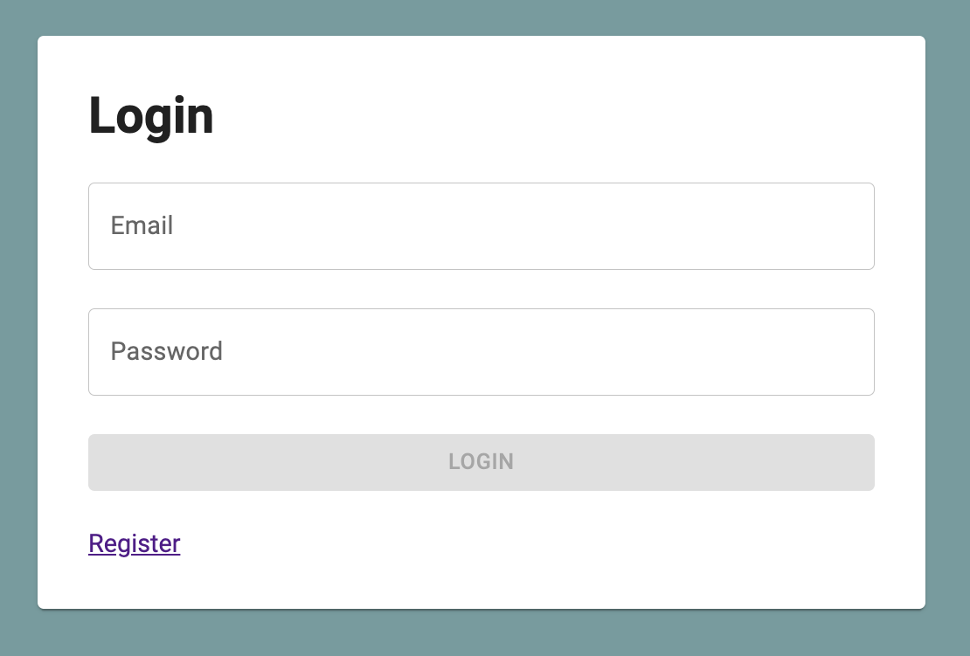
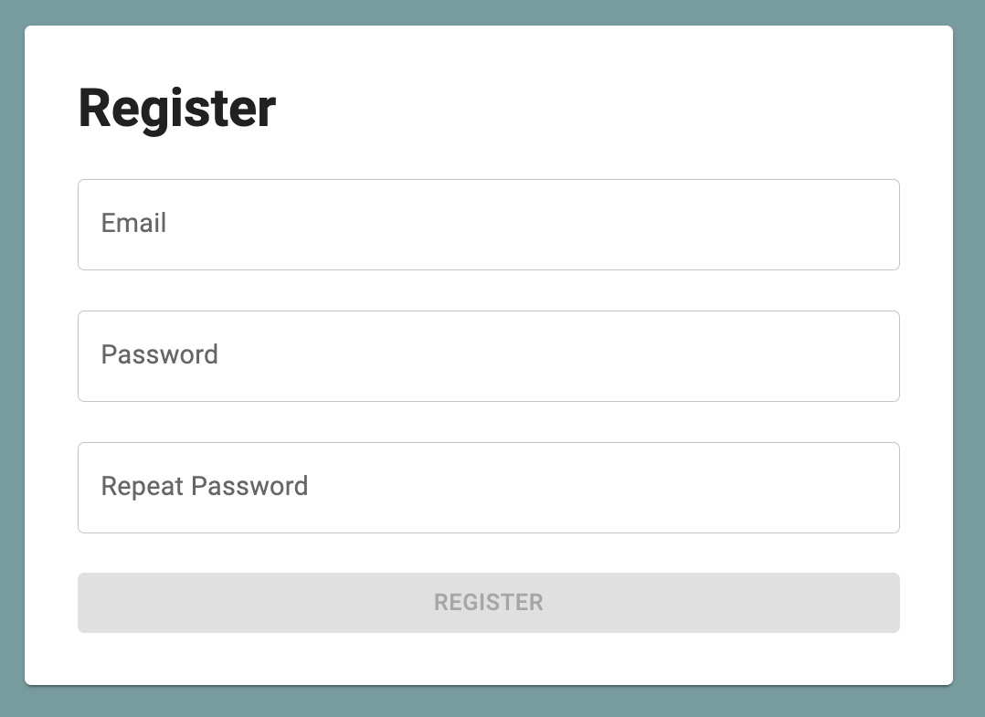
Forms

Slide 60
Async calls AXIOS
Promise based HTTP client
> npm install axios
axios({
method: 'get',
url: 'https://test.com'
})
.then((response) => {
// TODO
});

Slide 61
AXIOS interceptors
axios.interceptors.request.use(
function (config: any) {
return new Promise((resolve, reject) => {
const token = localStorage.getItem('token');
if (token) {
config.headers.authorization = `Bearer ${token}`;
}
resolve(config);
});
},
function (error: any) {
return Promise.reject(error);
}
);

Slide 62
React-Query
> npm i @tanstack/react-query
https://tanstack.com/query/v4/docs/react/installation

Slide 63
React-Query
import { QueryClientProvider, QueryClient } from '@tanstack/react-query';
const queryClient = new QueryClient();
<QueryClientProvider client={queryClient}>
. . .
</QueryClientProvider>

Slide 64
Routing - react-router-dom
> npm install react-router-dom
> npm install -D @types/react-router-dom
https://reactrouter.com/en/main

Slide 65
Routing – Wildcard path
import { createBrowserRouter } from 'react-router-dom';
import { Home } from './pages/home’;
import { NotFound } from './pages/not-found';
export const router = createBrowserRouter([
{
path: ‘/home’, element: <Home />,
},
{
path: ‘*’, element: <NotFound />,
},
]);
root.render(
<StrictMode>
<RouterProvider router={router} />
</StrictMode>
);

Slide 66
Routing – Lazy Loading
import { createBrowserRouter } from 'react-router-dom';
import { Home } from './pages/home’;
const NotFound = lazy(() => import('./pages/not-found'));
export const router = createBrowserRouter([
{
path: ‘/home’, element: <Home />,
},
{
path: ‘*’, element: <NotFound />,
},
]);
root.render(
<StrictMode>
<Suspense fallback={<div>Loading...</div>}>
<RouterProvider router={router} />
</Suspense>
</StrictMode>
);

Slide 67
Routing – URL Parameters
export const router = createBrowserRouter([
{
path: ‘/item/:id’, element: < Item />,
},
]);
export const Item = () => {
const { id } = useParams();
return <div>id: {id}</div>;
};

Slide 68
Routing – Menu Navigation
// Navigate to another route
<Link
to="item/1”
state={{ some: 'value’ }}
/>
const { state }= useLocation(); // get state
// Navigate to another route
// and get feedback if the “to” target route is active
<NavLink
to="/home"
style={({ isActive }) => ({
fontWeight: isActive ? 'bold' : ’’,
color: isActive ? 'red' : 'black’,
})}
>
Home
</NavLink>

Slide 69
Routing - Navigation
export const Redirect: FC = () => { return <Navigate to="/login" replace={true} />;
};

Slide 70
Routing - AuthGuard
export const AuthGuard: FC<PropsWithChildren> =
({ children }) => {
const { loggedIn } = useAuth();
return <>{
loggedIn ?
children :
<Navigate to="/login" replace={true} />
}</>;
};

Slide 71
Routing - DeepLinks
export const AuthGuard: FC<PropsWithChildren> =
({ children }) => {
const { loggedIn } = useAuth();
if (!loggedIn) {
// store the current location and redirect after login
localStorage.setItem('deepLink', window.location.href);
}
return <>{
loggedIn ?
children :
<Navigate to="/login" replace={true} />
}</>;
};

Slide 72
Internationalization
> npm install react-i18next i18next
https://react.i18next.com/getting-started

Slide 73
Internationalization
import enComponents from './en/components.json';
export const initI18n = () =>
i18n.use(initReactI18next)
.init({
resources: {
en: {
components: enComponents,
},
},
lng: 'en', fallbackLng: 'en’,
});
export const useComponentsTranslation = (componentName?: string) =>
useTranslation(
'components’,
componentName ? { keyPrefix: componentName } : undefined
);

Slide 74
Internationalization
const { t } = useComponentsTranslation('AppContainer’);
…
<Button>
{t('home')}
</Button>

Slide 75
Create a note

Slide 76
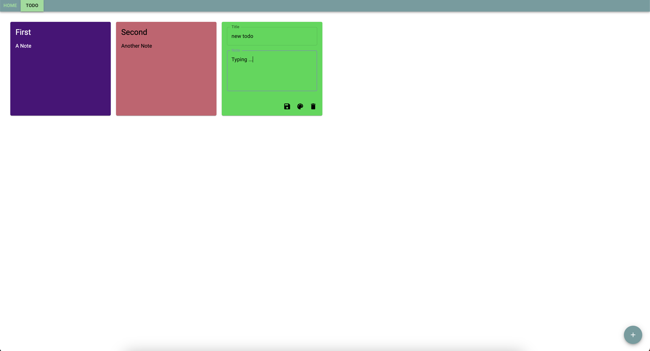
APP

Slide 77

Redux
Centralized state container
Flexible
Predictable
Debuggable
https://redux.js.org/
https://redux-toolkit.js.org/

Slide 78
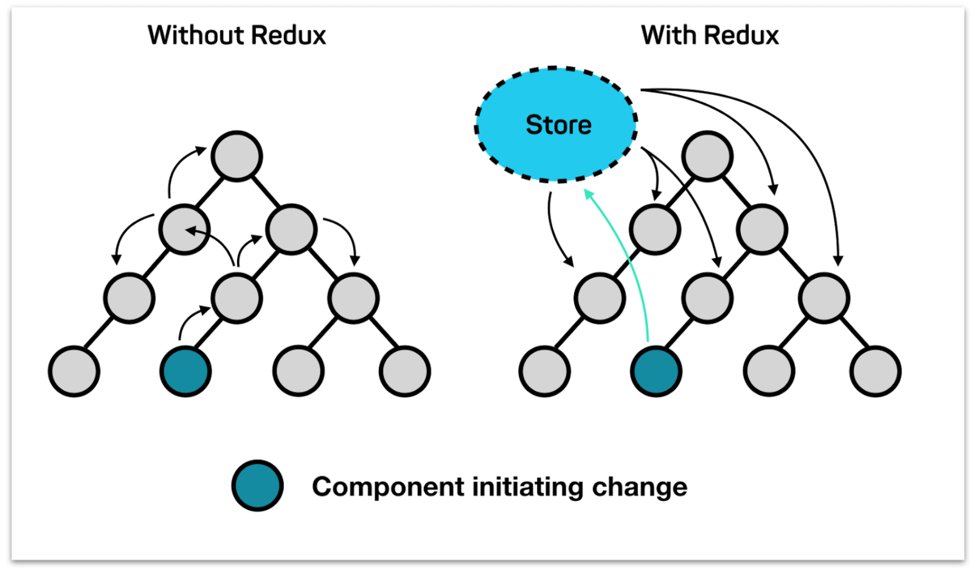
Redux store

Slide 79
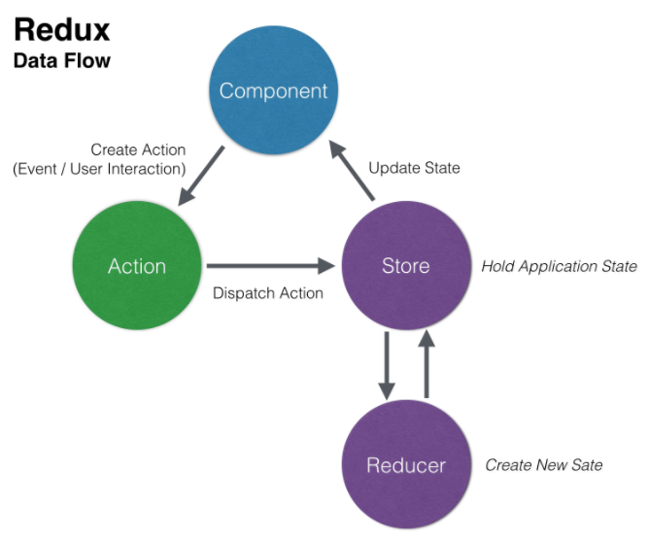
Redux Data Flow

Slide 80
Setup Redux
> npm install react-redux
> npm install @reduxjs/toolkit
> npm install redux-logger
> npm install -D @types/redux-logger

Slide 81
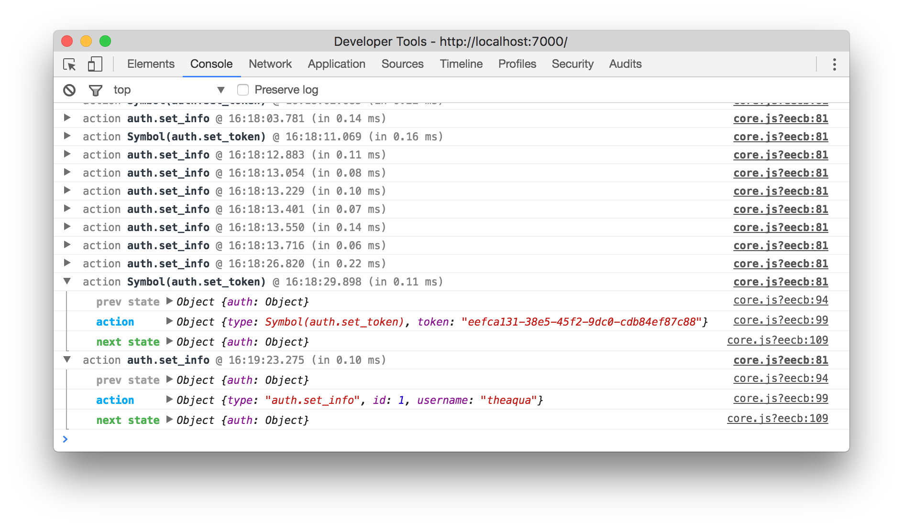
Redux Logger

Slide 82
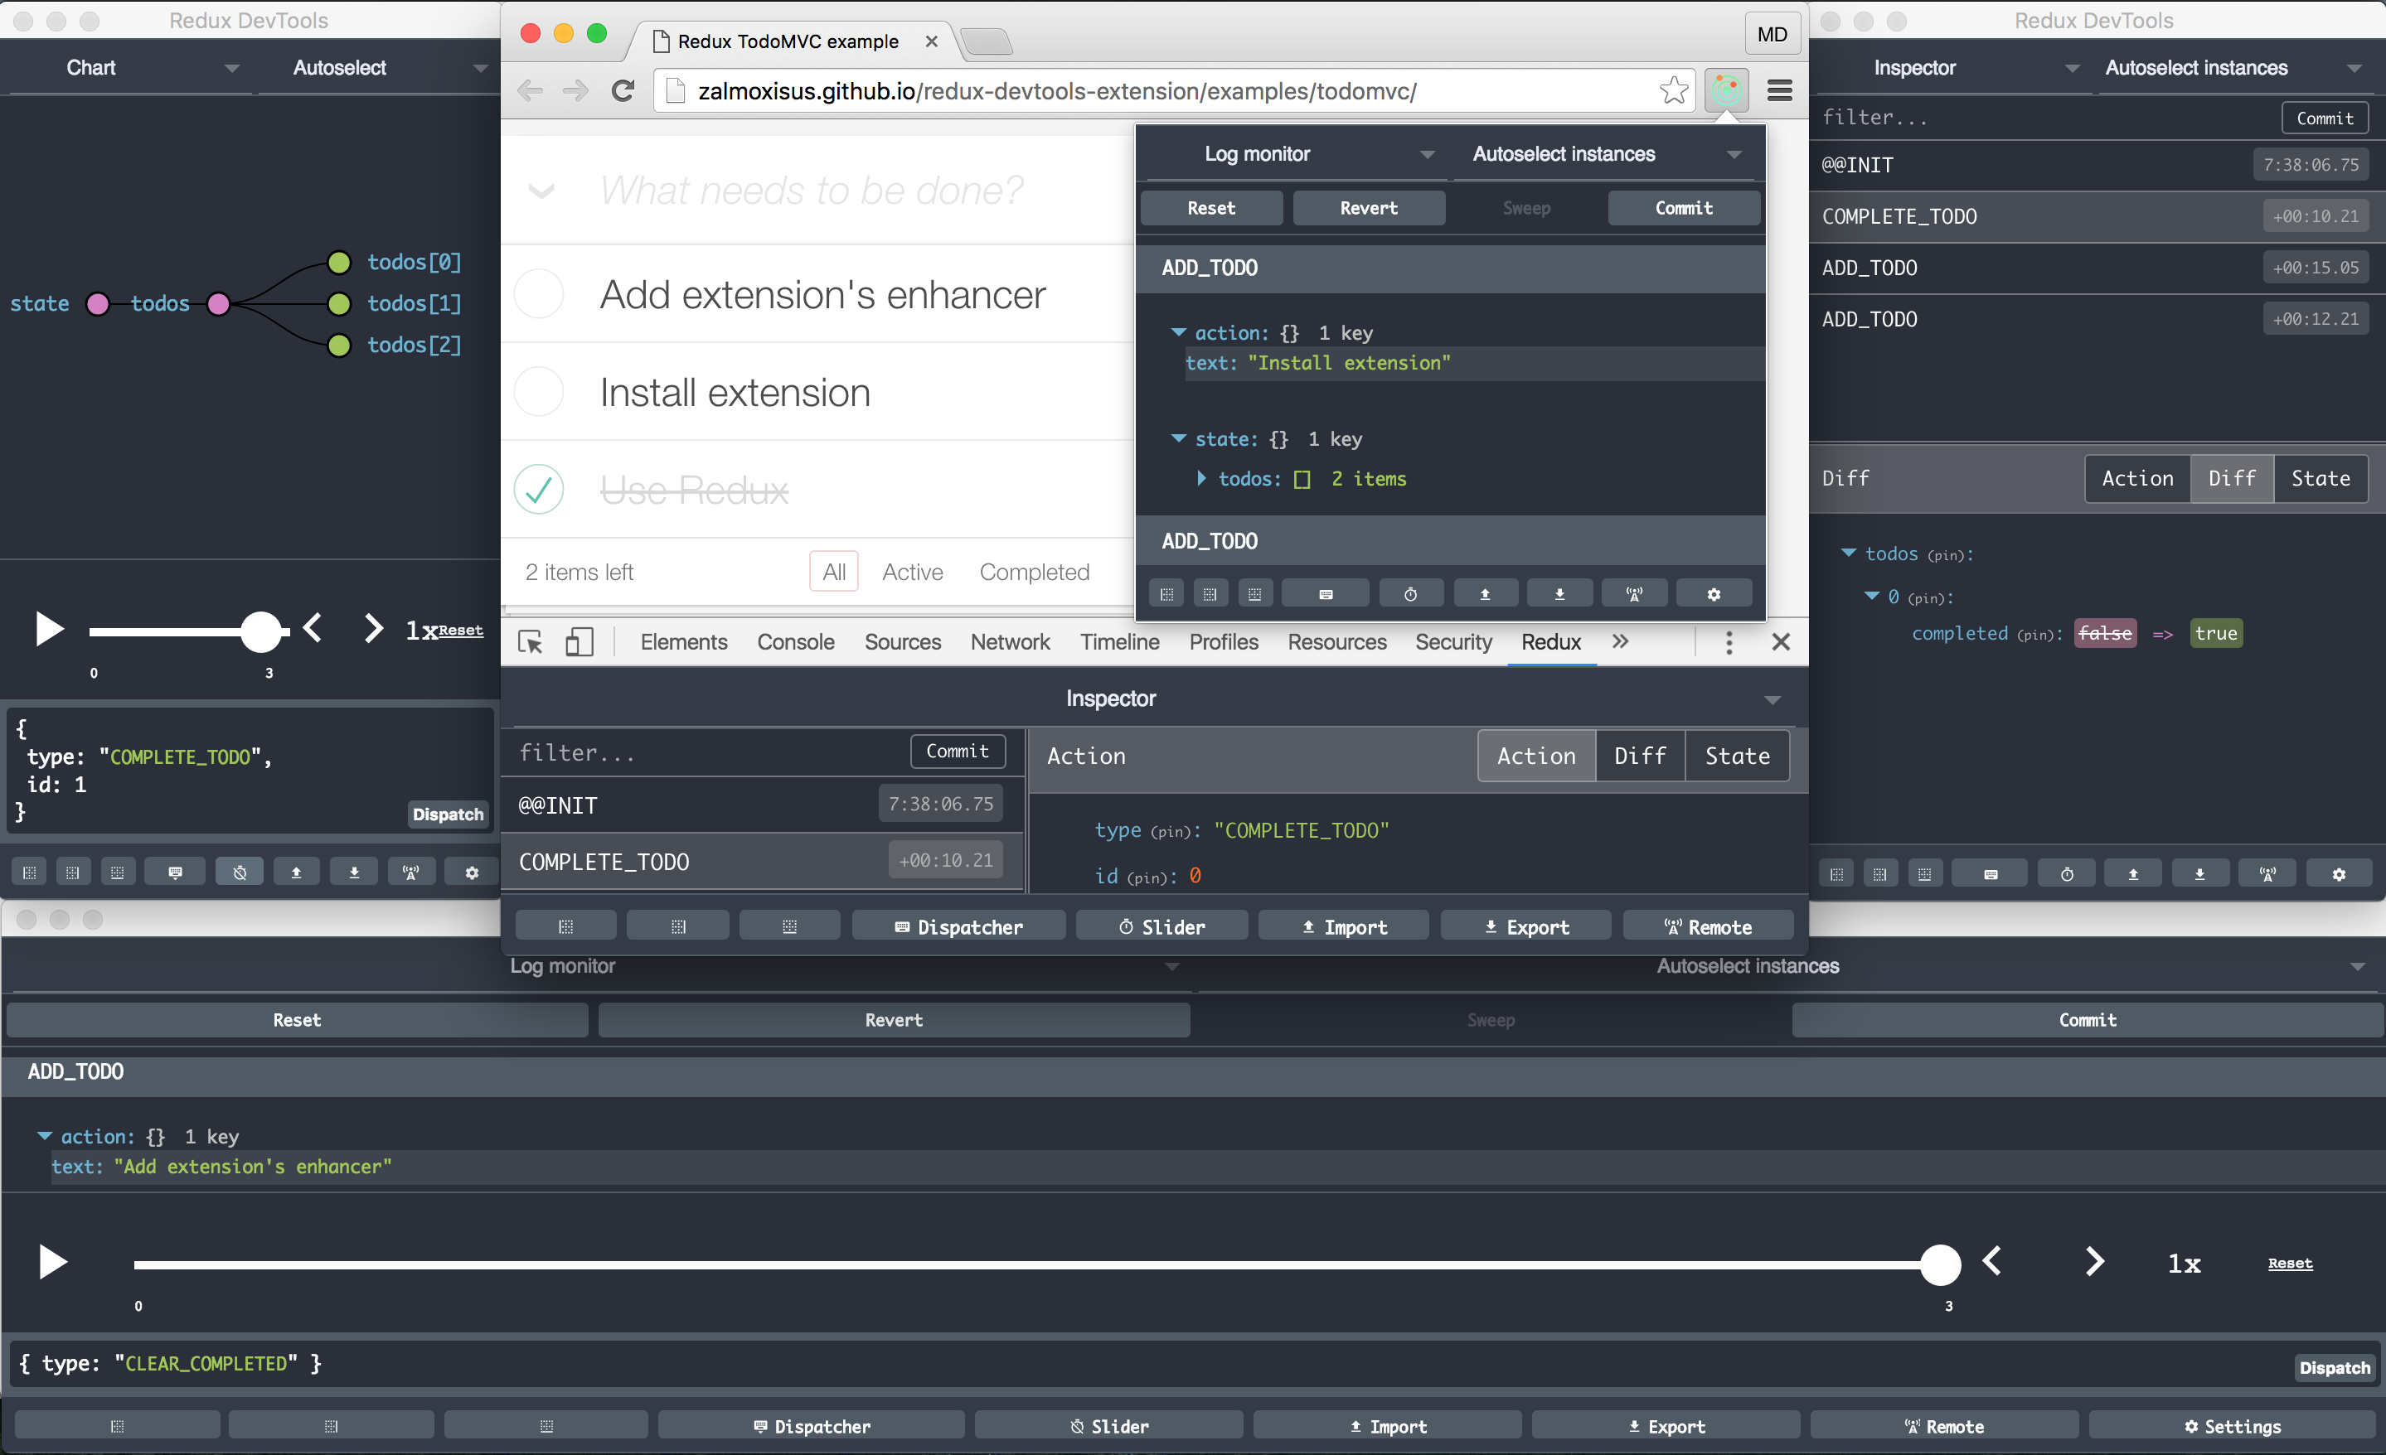
Redux DevTools
https://chrome.google.com/webstore/detail/redux-devtools/lmhkpmbekcpmknklioeibfkpmmfibljd

Slide 83
Contact
Sopra Steria Custom Software Solutions GmbH Bothestr. 11 81675 Munich css.soprasteria.de
Alexander Kucksdorf E-Mail: alexander.kucksdorf@soprasteria.com Phone: +49 151 4023 0063
Michel Frenken E-Mail: michel.frenken@soprasteria.com Phone: +49 151 4023 0117
Christian Noll E-Mail: christian.noll@soprasteria.com Phone: +49 151 4023 0082

Slide 84
Alexander Kucksdorf
E-Mail: akucksdorf@it-economics.de
Phone: +49 151 4023 0063
Vladimir Daskalov
E-Mail: vdaskalov@it-economics.de
Phone: +49 151 4020 1811

